Slide 1
Articula
Don’t just solve problems, articulate your solutions.
AI powered – DSA platform.
- Dhruv Jain

Slide 2
Problem
01
DSA Platforms Test the Answer. Interviews Test the Candidate.

Slide 3
DSA Platforms Test the Answer Interviews Test the Candidate.
Traditional coding platforms primarily answer: “ Did your code solve the problem?”
But an actual technical interview also evaluates:
Can the candidate explain their approach?
Can they identify edge cases?
Can they communicate their thought process clearly?
Key Gap
Code correctness ≠ Interview readiness
Our platform bridges this gap by combining coding + voice + AI evaluation + adaptive interviewing into one workflow.

Slide 4
Architecture
02
Proposed Pipeline

Slide 5
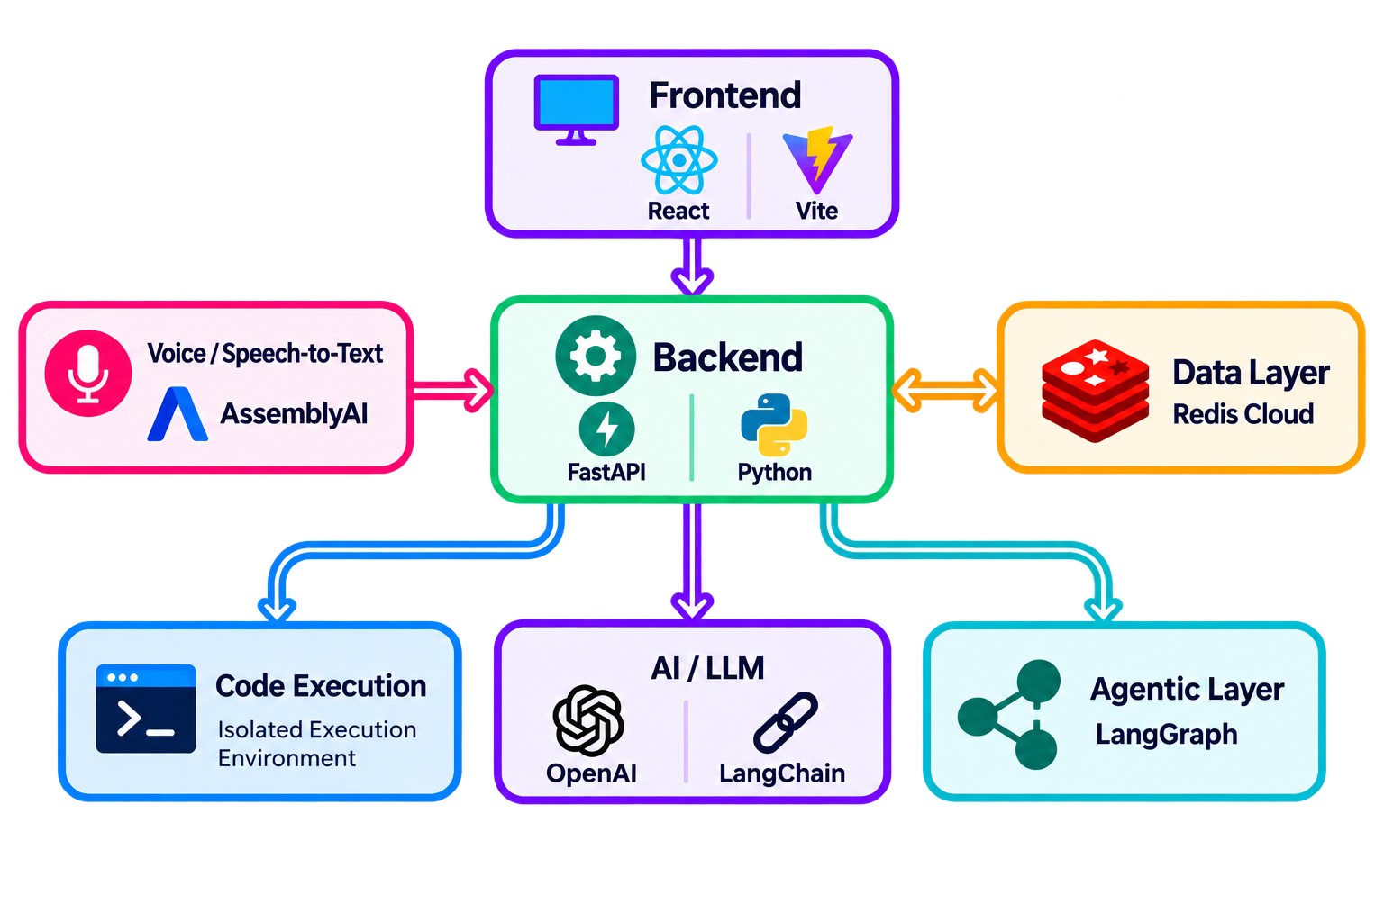
Architecture Choices

Slide 6
Solution
03
An AI Interview Simulator for DSA Preparation

Slide 7
An AI Interview Simulator for DSA Preparation
Candidate Flow
Select Problem Choose topic and difficulty.
Solve Write the solution in an in-browser code editor.
Explain Verbally explain approach, complexity, edge cases and optimizations.
Evaluate AI analyzes both the solution and explanation.
Receive Feedback Get recruiter-style insights and improvement suggestions.
Track Progress Store interview history and performance data.

Slide 8
Testing
04
Critical Test Scenarios

Slide 9
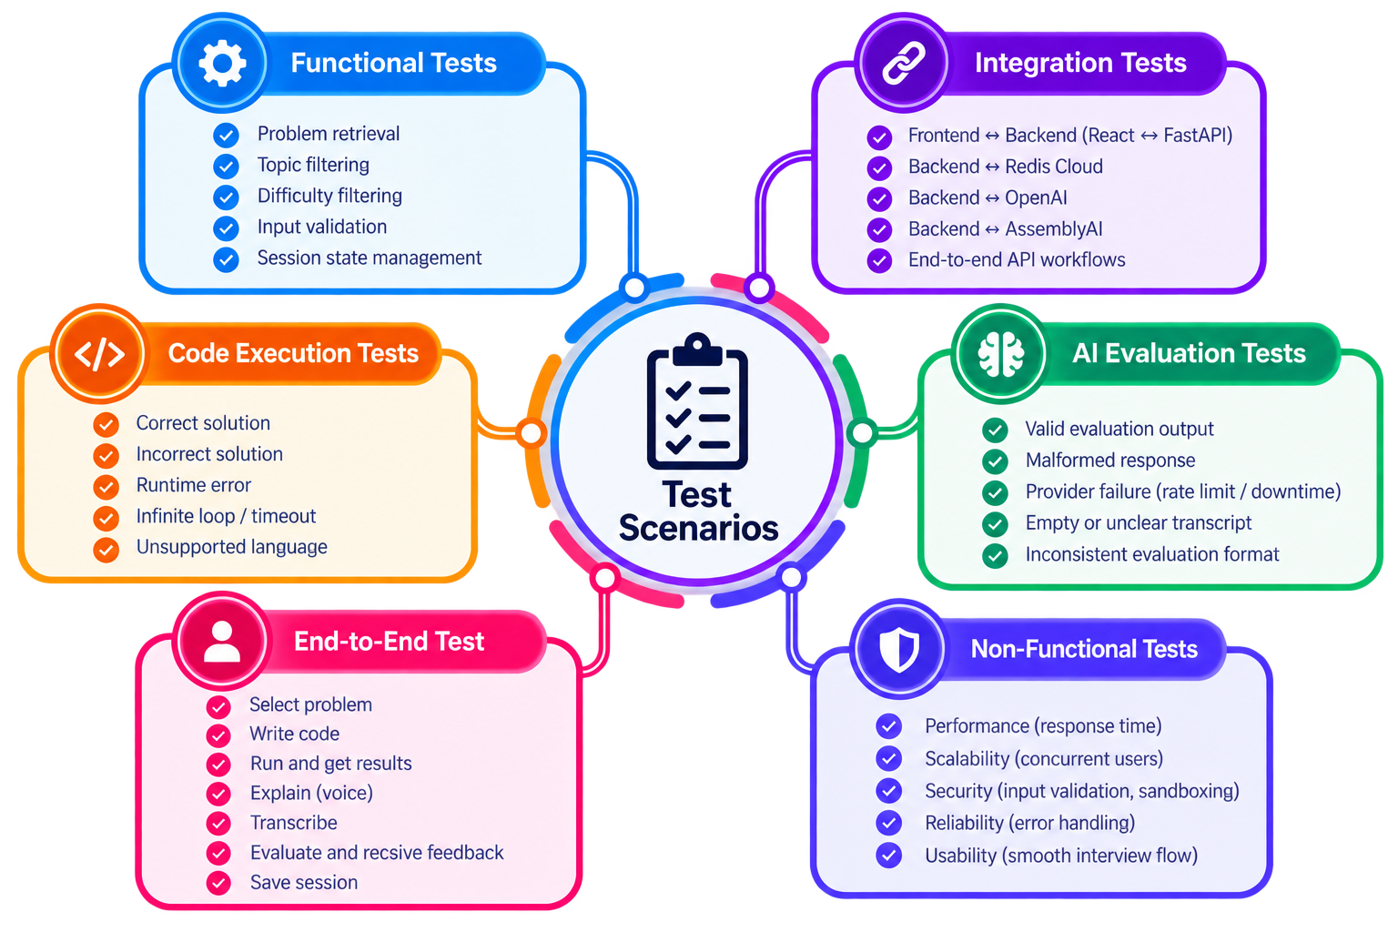
Critical Testing Scenarios

Slide 10
Agentic AI
05
Adaptive AI agent

Slide 11
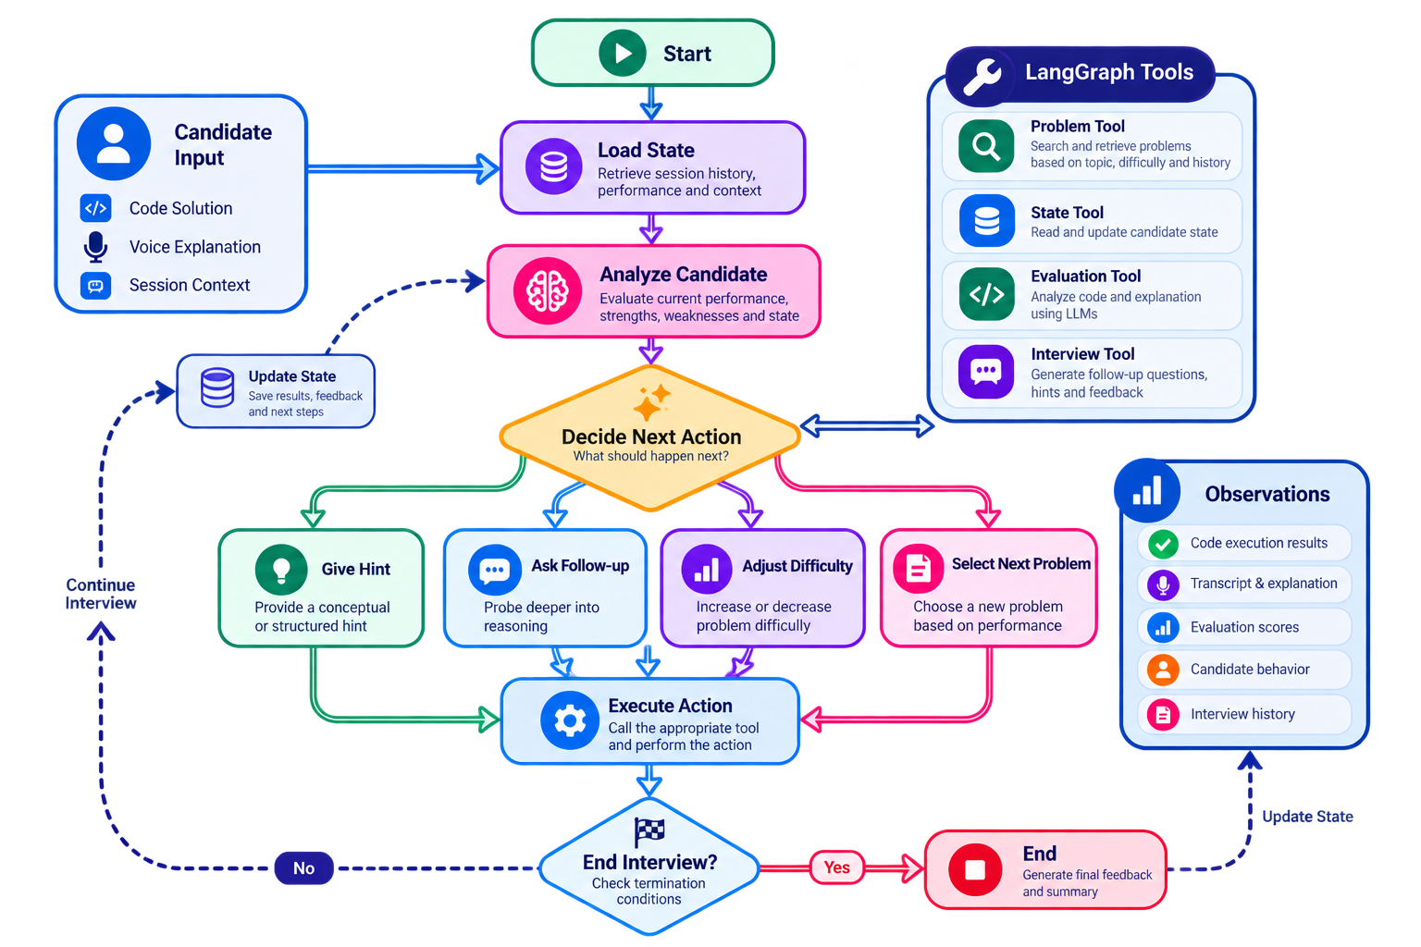

Slide 12
Design Tradeoffs
06
The adjustments.

Slide 13
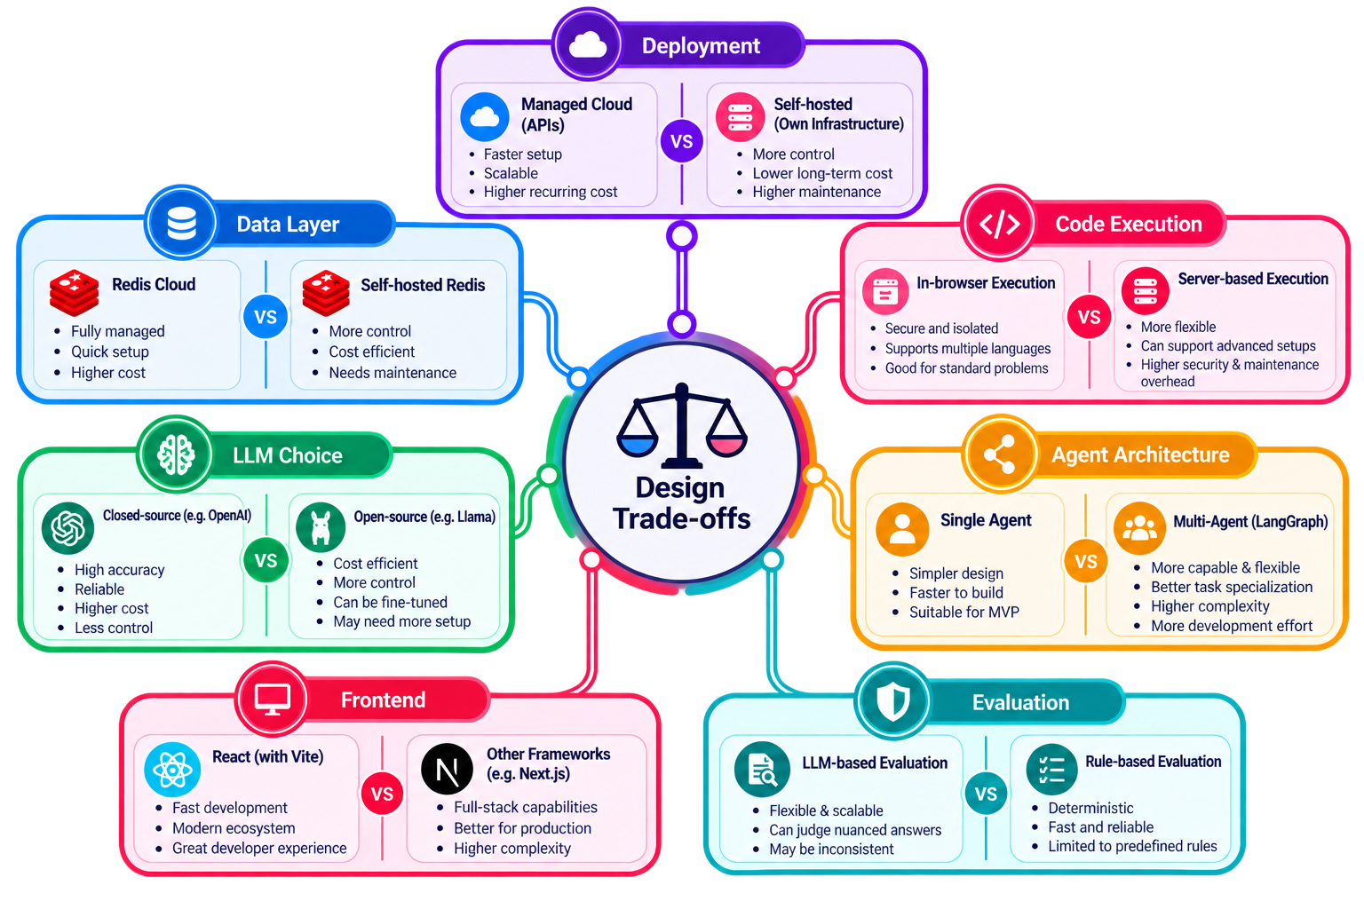

Slide 14
Thank You

